Slide 1

Introduction to Spring-Boot with CRUD Operations
Building a Simple RESTful API
Abhijite Deb Barman
Id : 2002029

Slide 2
Agenda
What is Spring Boot ?
It’s features
What is CRUD ?
Flow Architecture
Setting Up a Spring Boot Project
Creating Packages
Implementing CRUD modules
Testing CRUD Operations
Q & A Session
Conclusion

Slide 3
Introduction of Spring Boot
Spring Boot is an open-source Java-based framework for building standalone, production-grade Spring applications.
Original Author: Rod Johnson
Developer: VMware
Initial Release: April 2014
Stable Release: 3.2.5(18 April 2024)
Written in: JAVA
Platform: JAVA Enterprise Edition

Slide 4
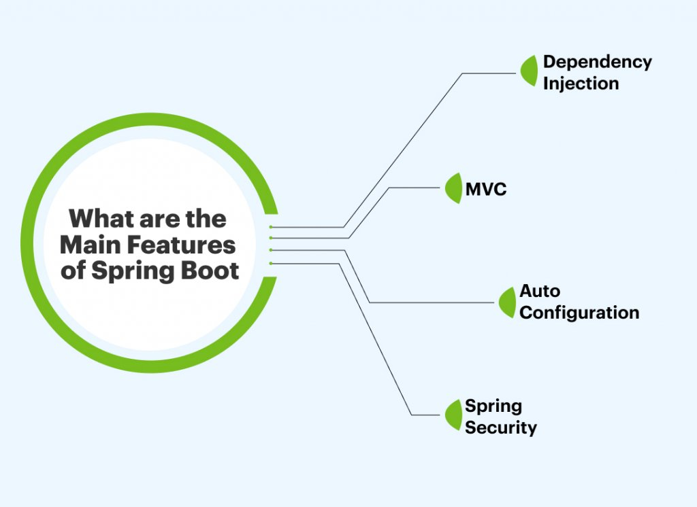
Features

Slide 5
Features
Dependency Injection
-Dependency( external library ) injection in Spring Boot simplifies codes by handling the management and provision of the necessary components.
MVC(Model View Controller)
-Model : It's responsible for managing the application's data, including tasks like retrieving data from a database, processing it, and updating it.
-View: The View receives data from the Model and displays it in a user-friendly format.
-Controller: The Controller acts as an intermediary between the Model and the View.

Slide 6
Features
Auto-configuration:
-It refers to the automatic setup of application components and infrastructure based on the dependencies and configuration present in the project
Spring Security
- Spring Security is a powerful authentication and authorization framework for securing Java applications, particularly those built using the Spring

Slide 7
Benefits of Using Spring Boot
Efficiency: Minimizes boilerplate code and configuration.
Rapid Development: Quickly prototype and develop applications.
Convention Over Configuration: Reduces manual setup and configuration.
Production-Ready: Includes features for monitoring, security, and more.
Community and Support: Active community and extensive documentation.

Slide 8
CRUD
CRUD stands for Create, Read, Update, and Delete. It represents the basic operations that can be performed on data in a database.
Key Points:
Create: Adding new records to the database.
Read: Retrieving existing records from the database.
Update: Modifying existing records in the database.
Delete: Removing records from the database.

Slide 9
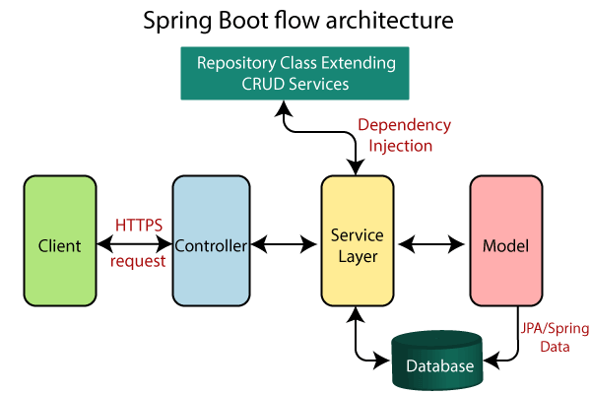
Architecture

Slide 10
Responsibility of Controller
→ Receive incoming HTTP requests from clients.
→ Process requests by invoking appropriate business logic.
→ Return HTTP responses, typically in the form of JSON, XML, or HTML, depending on the client's request.

Slide 11
Responsibility of Service
.
→Implement and encapsulate business rules and logic.
→Control transaction boundaries for operations that involve multiple database interactions.
→ Convert data between different formats or representations as required by the application.

Slide 12
Responsibility of Model
→ Define data entities.
→ Encapsulate data and behavior.
→ Define attributes and relationships.
Implement validation logic.
Create Data Transfer Objects (DTOs).

Slide 13
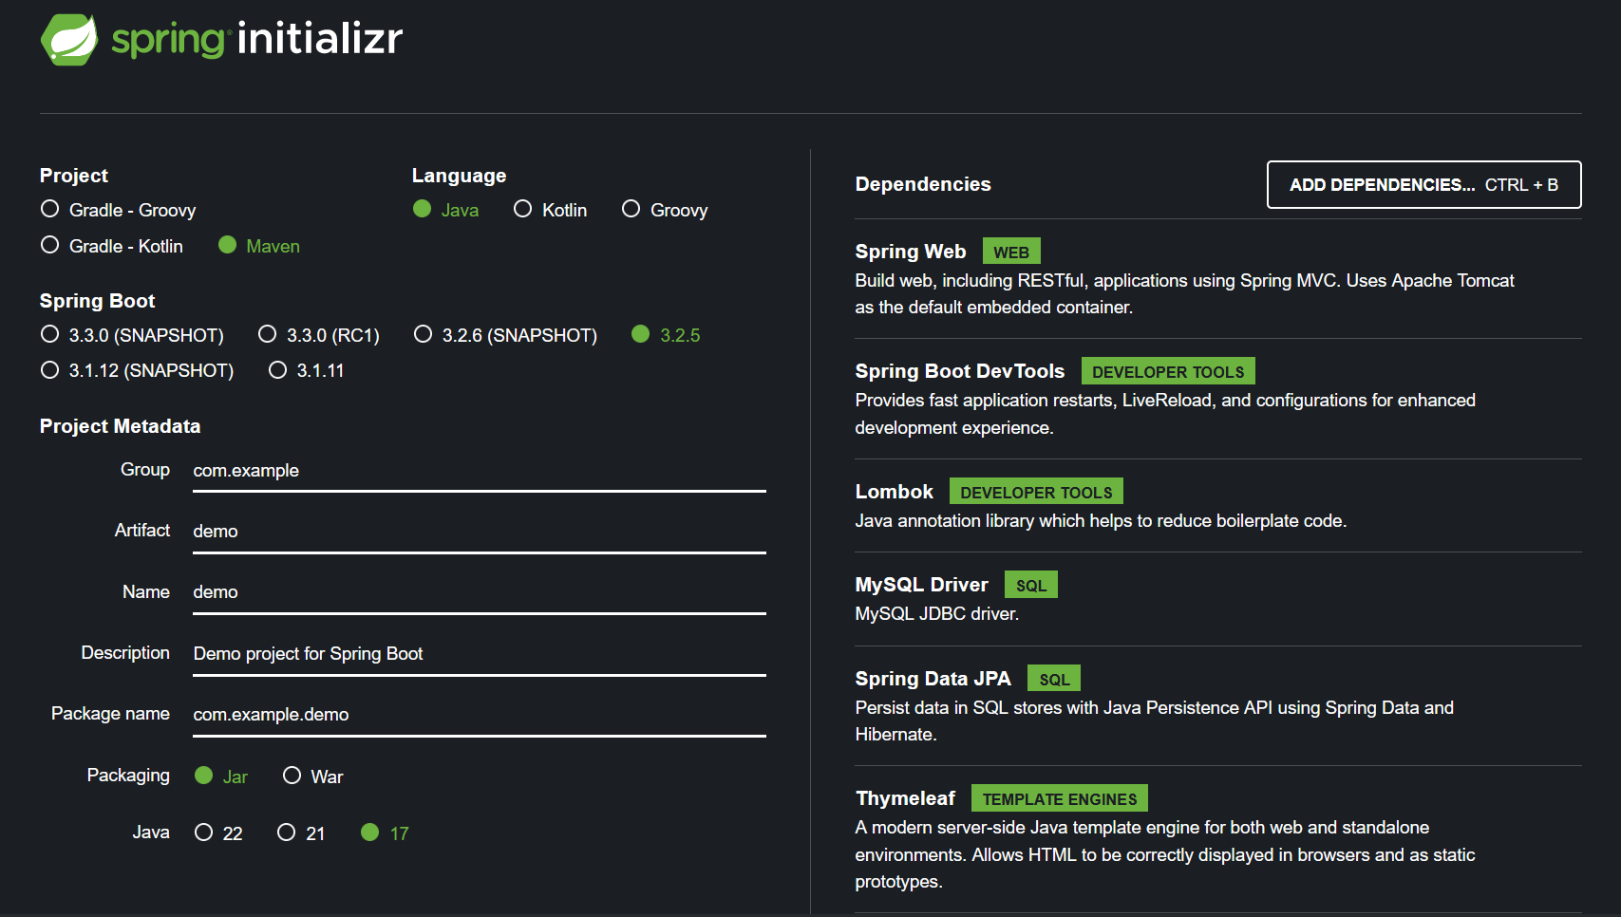
Spring initializr (www.start.spring.io)

Slide 14
Dependencies
Dependency : A dependency refers to an external library or module that your application relies on to provide certain functionality.
1.Spring Web(build applications using Spring MVC)
-module within the Spring Framework
-provides support for building web applications
2.Spring Data JPA (Persist data in SQL stores with java Persistence API using Spring Data)
-provides a higher-level abstraction over JPA
-simplifying common data access tasks

Slide 15
Dependencies
3.Thymeleaf( Allows HTML to be correctly displayed in browsers and as static prototypes)
-helps create the visual part of a web application
-insert dynamic data from the backend
4.MySql Driver(MySQL JDBC driver )
Makes a connection between java app and MYSQL database)
5.Lombok(java annotation library which helps to reduce boilerplate)
Lombok eliminates the need to write repetitive code
such as getters, setters, constructors etc.

Slide 16
Dependencies
6.Spring Boot Dev Tools
provide fast application restarts, Live Reload, and configurations for enhanced development experience

Slide 17
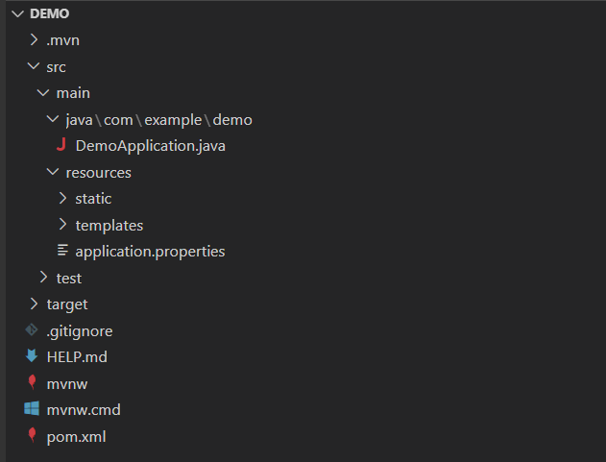
Demo Application

Slide 18
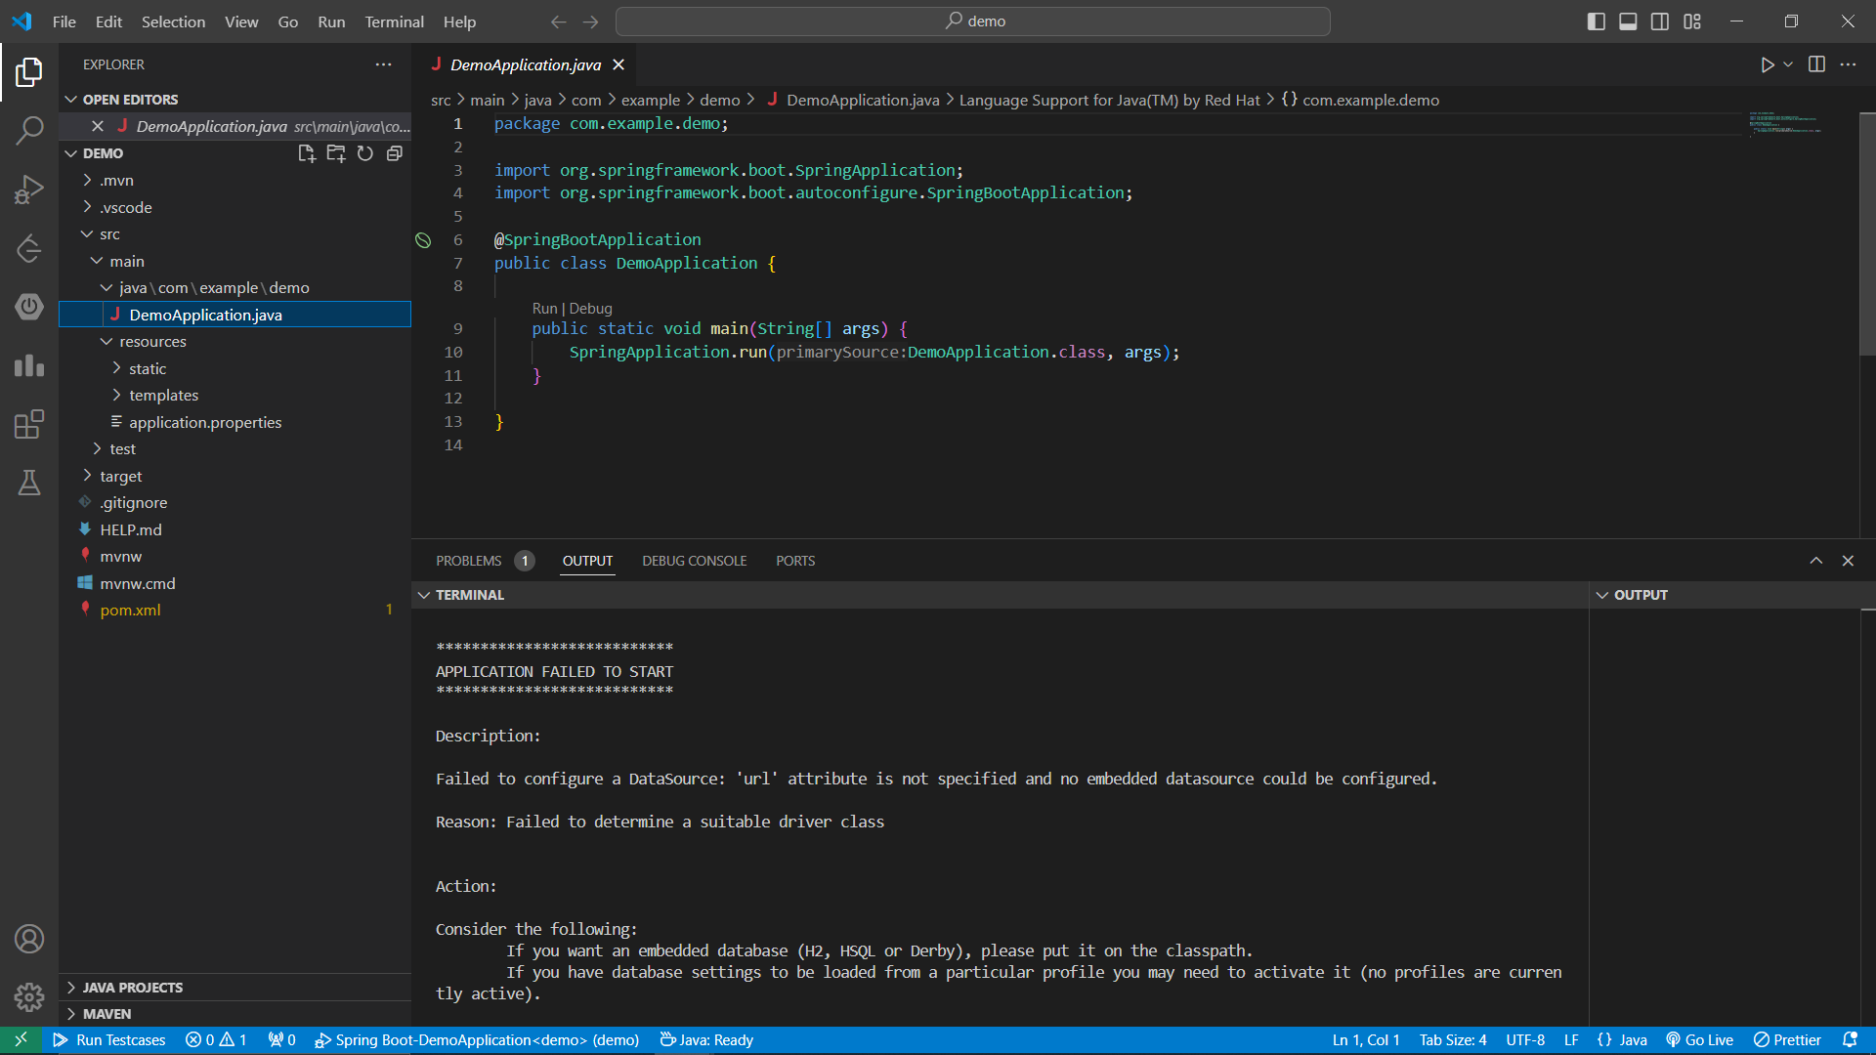

Slide 20
Database Connection
spring.application.name=demo
spring.datasource.url=jdbc:mysql://localhost:3306/formdatabse
spring.datasource.username=root
spring.datasource.password=abhijite
spring.datasource.driver-class-name=com.mysql.cj.jdbc.Driver
spring.jpa.show-sql=true
spring.jpa.hibernate.ddl-auto=update

Slide 21
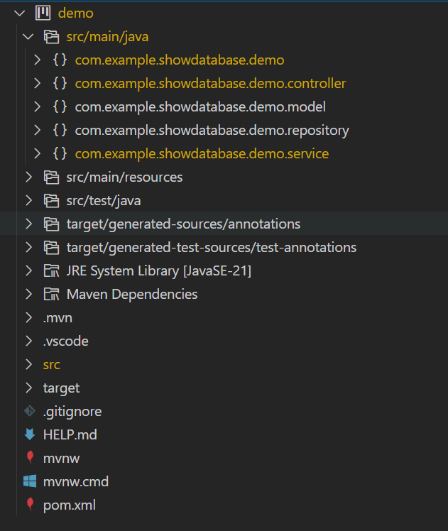
Create Four Packages under src/mian/java

Slide 23
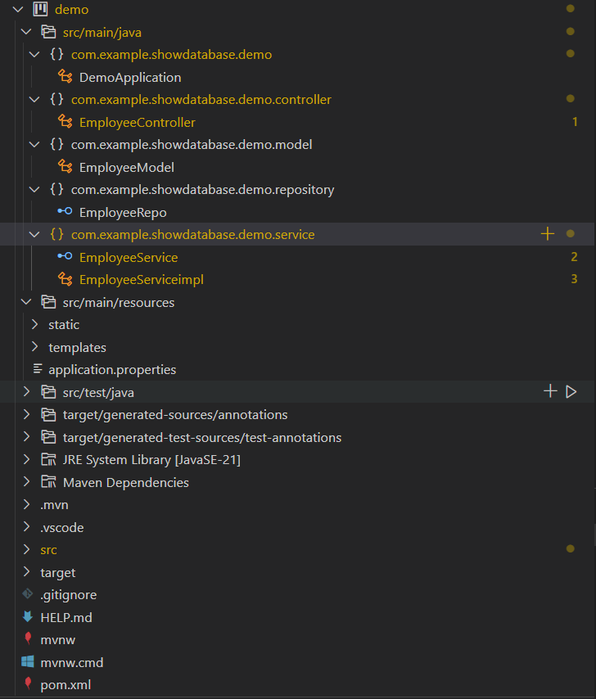
Create class & interface under these packages

Slide 25
Model Package
Create a Java class
Annotated with @Entity
Declare Table name
Declare column with datatypes
Declare Getter and Setter Method
Set primary-key with @Id
Set table name with @Table(name=“table_name”)

Slide 26
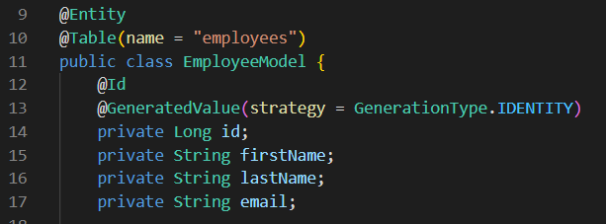
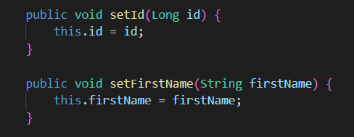
Model class

Slide 27
Repository Package
Create an interface
Annotated with @Repository
Extends JpaRepository< , >
Takes two Parameters
Model Java class name and primary key datatype

Slide 28
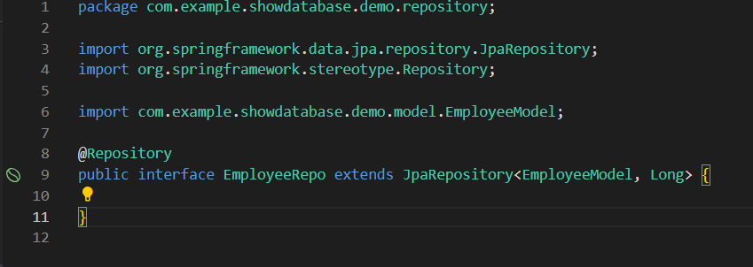
Repository Interface

Slide 29
Service Package
Create an interface
Annotated with @Service
Create abstract function
Create a Java class
Implements with service class
Implements those abstract function

Slide 30
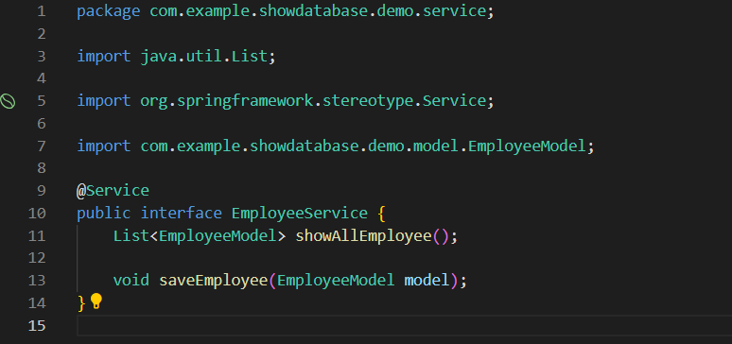
Service Interface

Slide 31
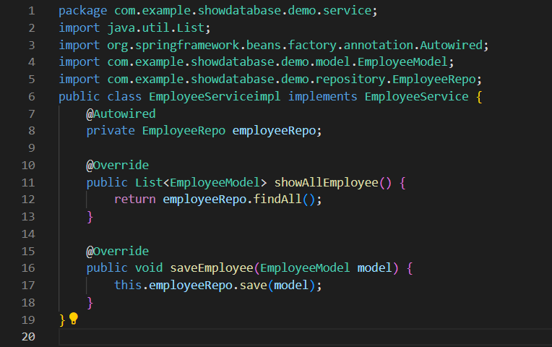
Service Class

Slide 32
Controller Package
Create a Java class
Annotated with @Controller
Annotated by @Autowired with repository
Marks a constructor, field, setter method, or config method as to be autowired by Spring's dependency injection facilities.

Slide 33
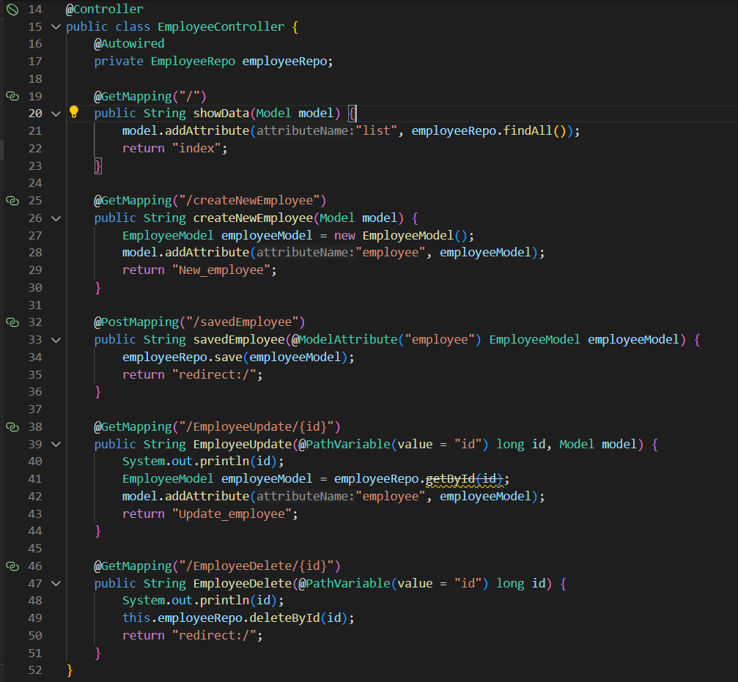

Slide 37
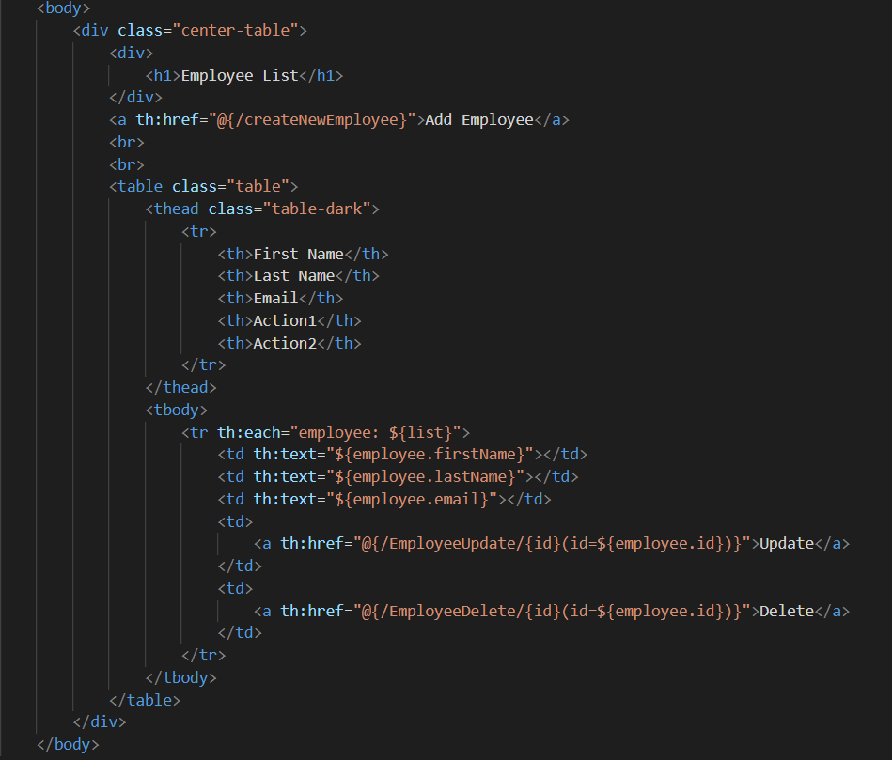

Slide 38
Model class

Slide 39
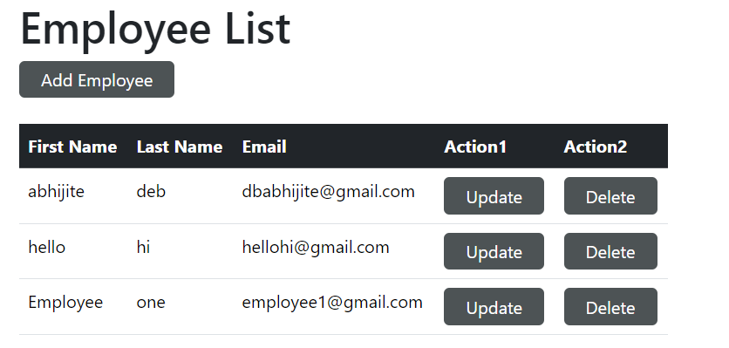
READ

Slide 40
CREATE

Slide 43
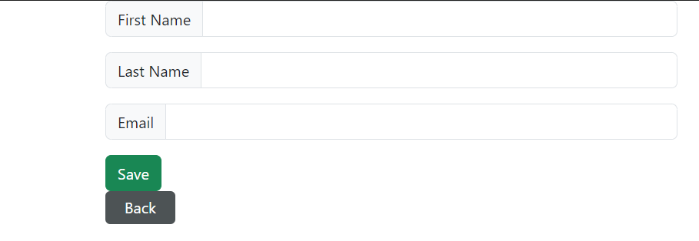
CREATE

Slide 45
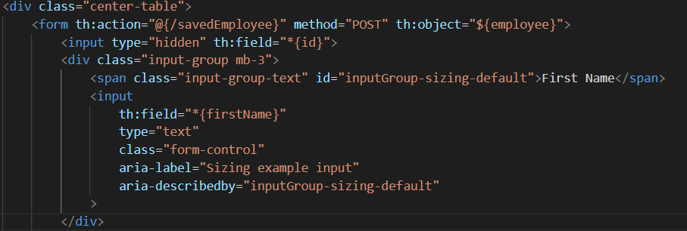


Slide 46
CREATE

Slide 49
CREATE

Slide 50
UPDATE

Slide 53
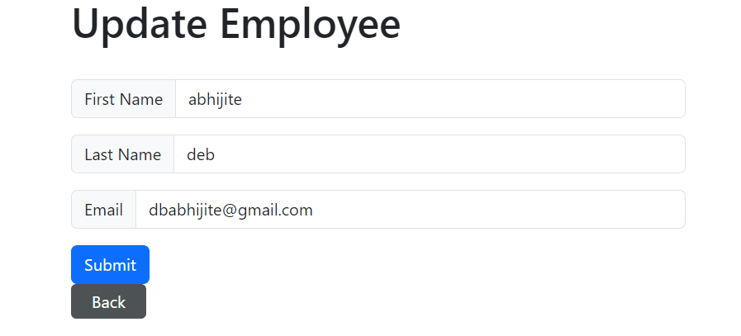
UPDATE

Slide 54
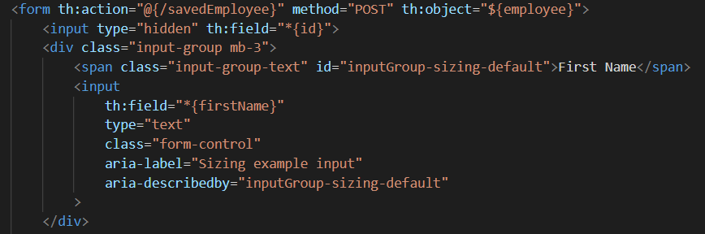

Slide 57
UPDATE

Slide 58
DELETE
58

Slide 62
Q & A Session

Slide 63
References
https://www.javatpoint.com/
https://spring.io/projects/spring-boot
https://www.w3schools.blog/spring-boot-tutorial

Slide 64
THANK YOU

